Slide 1
KITTING PROGRAM & PROCESS CONTROL
HCM, Oct 2015

Slide 2
KITTING PROCESS - MAIN CONTENT
1. PREREQUISITE TASKS OF KITTING PROCESS.
2. BUSSINESS MODEL , PRESENTATION & DATA ACCESS.
3. PROCESS OVERVIEW
Do It First, Make It Perfect Later

Slide 3

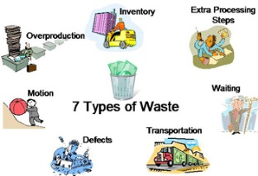



PREREQUISITE TASKS
SUPPORTING LEAN PROJECT TO SIMPLE PROCESS AND VISUAL MANUFACTURING ISSUE.
REMOVE MANUFACTURING WASTES.
3. SHORTEN LEADTIME AND DO JUST
IN TIME PROCESS.
4. REDUCE INVENTORY ON FLOOR/W.I.P.
5. TRACKING KPI AND GIVE CHANCES
TO CONTINOUS IMPROVEMENTs.
Do It First, Make It Perfect Later

Slide 4
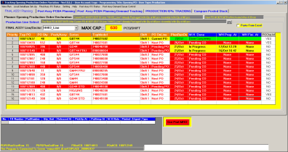
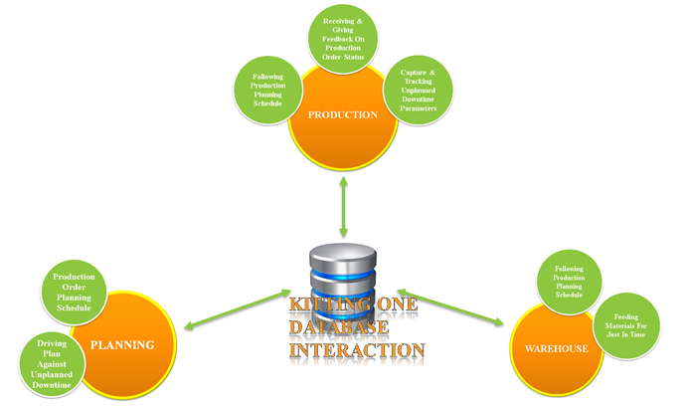
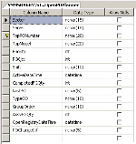
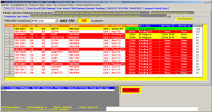
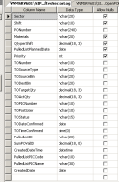
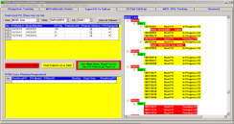
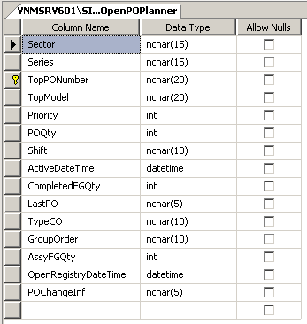
BUSSINESS MODEL
PRESENTATION
& DATA ACCESS
Do It First, Make It Perfect Later

Slide 5

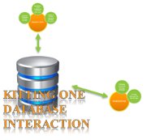


BUSINESS MODEL LAYER
PLANNING & KITTING INTERACTION
INPUT THE PLANNING SCHEDULE AND NOTICE THE POTENTIAL PENDING ON PRODUCTION ORDER.
DRIVING PLAN PRIORITY AGAINT UNPLANNED DOWNTIME
KITTING DATABASE INTERACTION
GIVING THE REAL TIME PRODUCTION ORDER STATUS:
Current PO on Line.
Quantity Packaging/Assembly.
Materials Kitting Preparation.
Planned/Unplanned Downtime Issues
SUPPORTING CONSTRAINTs FROM KITTING SYSTEM TO CAPACITY & PREVENTING FROM CONFLICTING TO PROCESS RULEs (AUTO PLANNING MODE).
Do It First, Make It Perfect Later

Slide 6

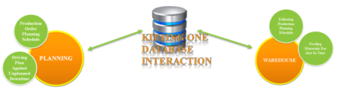
BUSINESS MODEL LAYER
PRODUCTION & KITTING INTERACTION
FOLLOWING PRODUCTION PLANNING SCHEDULE FROM VISUAL KITTING PANEL.
RECORD FEEDBACK ON PRODUCTION ORDER STATUS:
Quantity Packaging/Assembly.
Materials Kitting Preparation.
CAPTURE & TRACKING PLANNED/UNPLANNED DOWNTIME PARAMETERS.
GIVING PRODUCTION ORDER STATUS/PARAMETERS AND FEEDBACK AUTO TO PLANNERs/WAREHOUSE
DRIVE PRODUCTION ACTIVITIES AUTO TO NEXT PRODUCTION ORDER IN CASE OF UNPLANNED DOWNTIME HAPPENING.
KITTING ONE DATABASE INTERACTION
Do It First, Make It Perfect Later

Slide 7
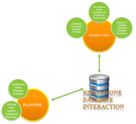

BUSINESS MODEL LAYER
WAREHOUSE & KITTING INTERACTION
FOLLOWING PRODUCTION PLANNING SCHEDULE FROM VISUAL KITTING PANEL.
FEEDING MATERIALS FOR JUST IN TIME.
CAPTURE THE MATERIALS PREPAREATION INTO KITTING SYSTEM.
RECORD AND CAPTURE THE STATUS/ISSUES OF KITTING ACTIVITIES.
CREATE THE PULL LIST OF MATERIALS IN THE WAY OF SUPPORTING TO REDUCE LEADTIME & WORKLOADs.
GIVING REALTIME VISUAL STATUS OF PRODUCTION DEMANDs TO FOLLOW UP.
SUPPORTING CONSTRAINTs FROM KITTING SYSTEM TO CAPACITY & PREVENTING FROM CONFLICTING TO PROCESS RULEs (AUTO PLANNING MODE).
KITTING ONE DATABASE INTERACTION
Do It First, Make It Perfect Later

Slide 8
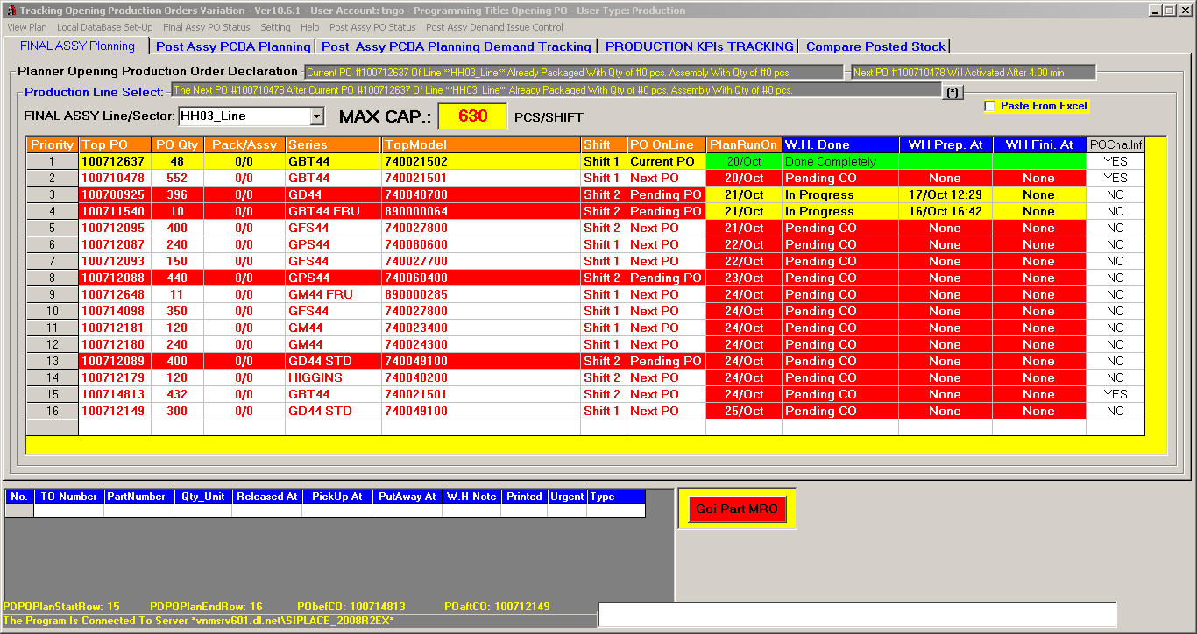
PRESENTATION LAYER
PLANNING & PRODUCTION USER INTERFACE
Do It First, Make It Perfect Later

Slide 9

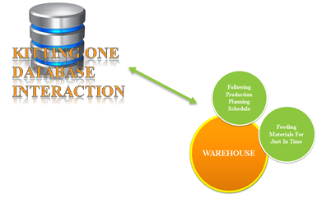
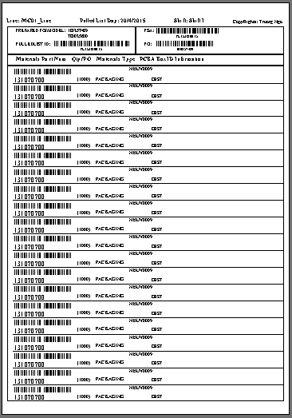
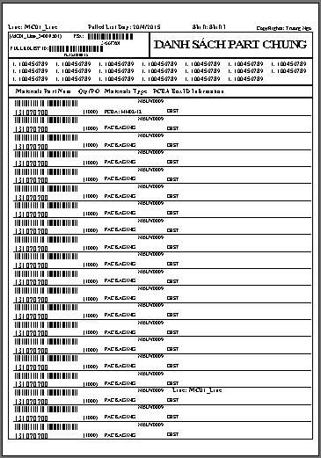
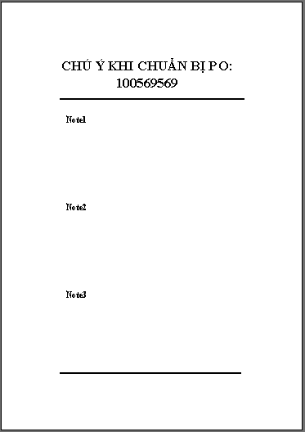
PRESENTATION LAYER
WAREHOUSE USER INTERFACE
- Pull List Of Common Materials For All PO.
- Pull List Materials Of Individual PO
- Real time Notice From Planners
Do It First, Make It Perfect Later

Slide 10

PRESENTATION – VISUAL CONTROL
MATERIALS PULL LIST FORMAT
OUTPUT PULL LIST OF MATERIALS INCLUDING FOLLOWING INFORMATION:
Pull List Of Common Materials For All PO: Materials Which Used By All Production Order Will Be Sum In Total Into One Group.
Pull List Materials Of Individual PO.
Real time Notice From Planners.
REAL TIME & CONSOLIDATED SHOWN ON PULL LIST:
Production Order & Model Number
Materials Part Number
Quantity In Sum.
MRO & Packaging Materials.
PCBA Packaging In Stock (BoxID, Stastus,..)
Destination Of Materials On Line.
Do It First, Make It Perfect Later

Slide 11
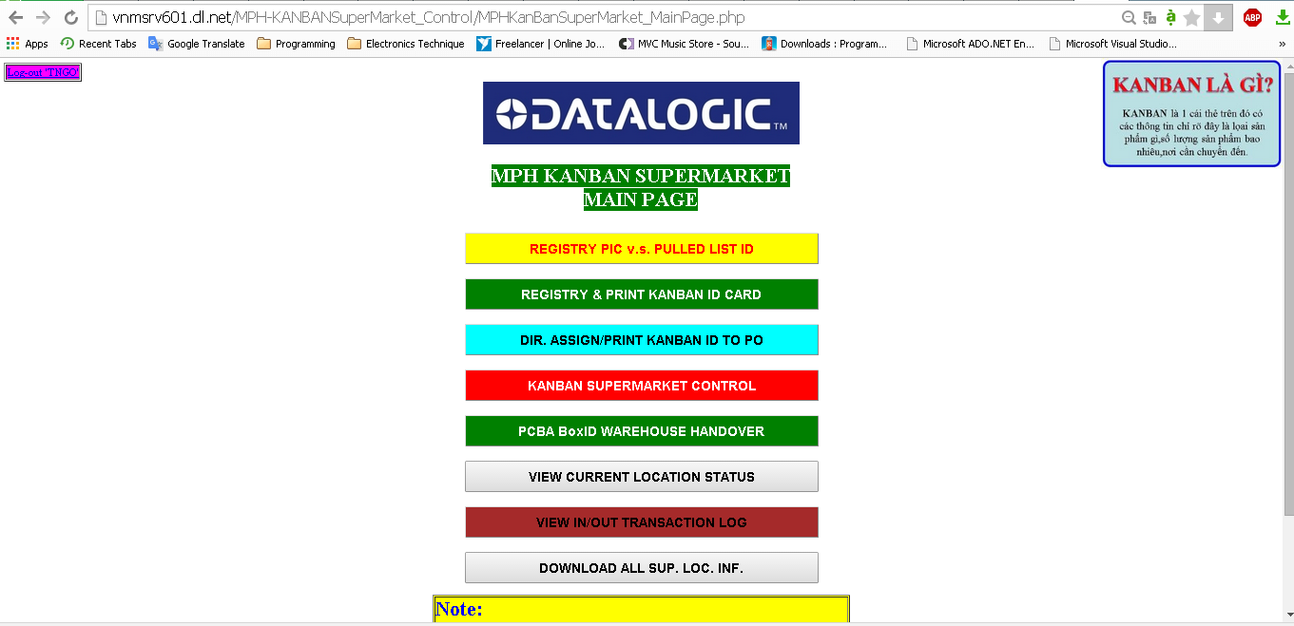
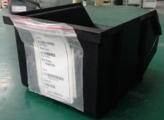
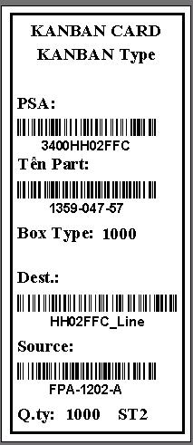
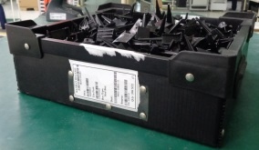
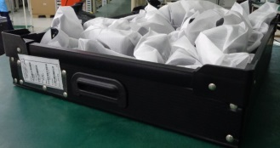
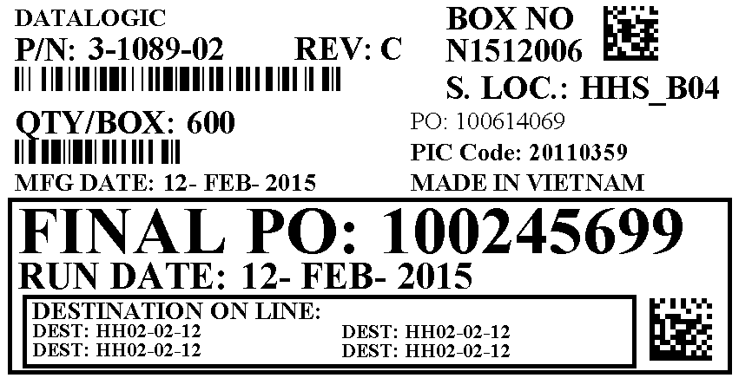
PRESENTATION – VISUAL CONTROL
MATERIALS KANBAN CARD
SMALL BOX
MEDIUM BOX
BIG BOX
PCBA KANBAN CARD
Do It First, Make It Perfect Later

Slide 12

DATA ACCESS LAYER
1. Database Of Line v.s. Capacity: for auto planning one PO added into Kitting Software basing capacity
2. Database Recording Planning Schedule:
Record current Planning Schedule.
Record all changes impact to Planning Schedule comes from:
Planners: Change Priority, Delete PO,…
Production: pending PO due to unplanned downtime, resume PO after downtime solved,…
Warehouse: the status of materials preparation (kitting), pending PO due to shortage of materials,…
3. Database Set-up For Kitting:
Locations of materials dedicated for feeding into line.
Parameters of Kanban Box (PSA, Part Number, Destination, Quantity,…)
4. Database Recording Issues From Manufacturing To Calculate KPI:
The issues of refeeding materials.
Planned/Unplanned downtimes.
Do It First, Make It Perfect Later

Slide 13
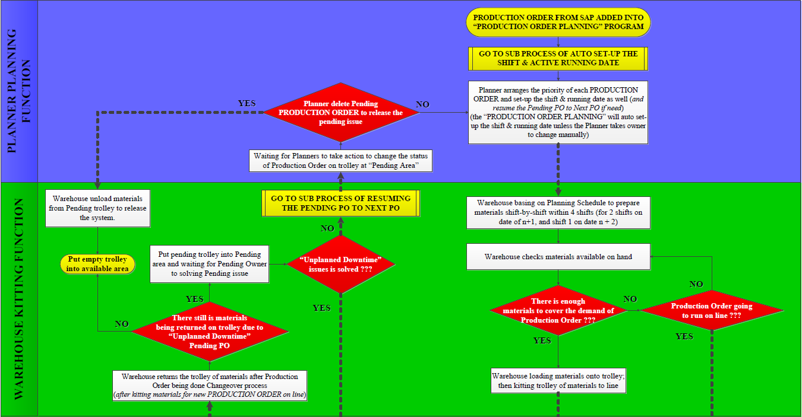
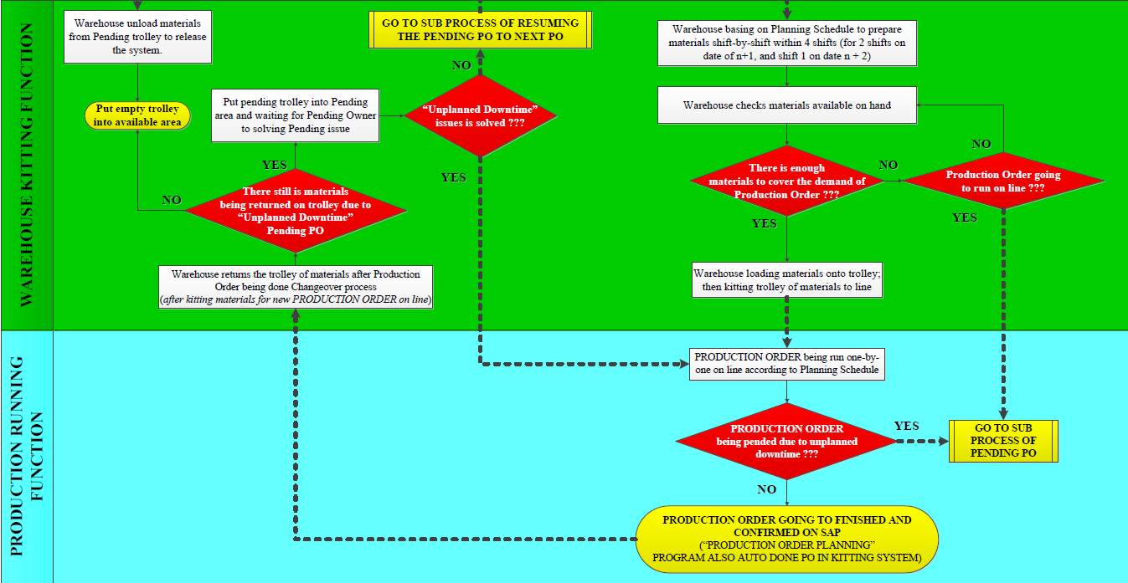
PROCESS OVERVIEW
Do It First, Make It Perfect Later

Slide 14
PROCESS OVERVIEW
Do It First, Make It Perfect Later

Slide 15
WHERE WE ARE?
LIMITATIONs AND FUTURE IMPROVEMENTs
ACHIEVEMENTs:
SUCCESFULLY SUPPORTING LEAN PROJECT:
+ SIMPLE PROCESS AND VISUAL MANUFACTURING ISSUE.
+ DEPLOY JUST IN TIME PROCESS.
+ VISUAL CONTROL & REMOVE PARTs IN PROGRESS
+ IMPROVE CAPACITY BY OPTIMIZING PROCESS LEAD TIME
LIMITATIONs:
1. WORKLOADS FOR RE-FEEDING MATERIALS TO COVER DEFECTIVE PARTs
2. NO TOOLs SUPPORTING TO LINK TO SAP FOR ACCESSING STATR DATE, END DATE & CONFIRMATION OF ONE SPECIFIC PRODUCTION ORDER
FUTURE IMPROVEMENTs
DEPLOYING KITTING FOR WHOLE FACTORY
LINK TO PCB/PCBA PROCESS TO CONTROL INVENTORY OF PCB/PCBA
Do It First, Make It Perfect Later

Slide 16
Thank you

